Slide 1
Attachment Theory
Supporting the needs of looked after and previously looked after children
Dr Beth Turner
Specialist Educational Psychologist for the Virtual School
Windsor and Maidenhead
Notes:
Intro video https://www.youtube.com/watch?v=J-X6ZrrYAew&index=1&list=PLS_VOF2UN3BFlQ7hv1-qBDH2v0LCAWu7p
Final video https://www.youtube.com/watch?v=otEa4OlH-_w&list=PLS_VOF2UN3BFlQ7hv1-qBDH2v0LCAWu7p&index=31

Slide 2

Attachment Theory
“lasting psychological connectedness between human beings”
(John Bowlby, 1969, p.194)
Attachment is about relationships, and our mental models of relationships. A child’s first attachment is vitally important. The carers ability to attune themselves to the infant’s needs, and to respond appropriately, is important for the development of a secure attachment.

Slide 3
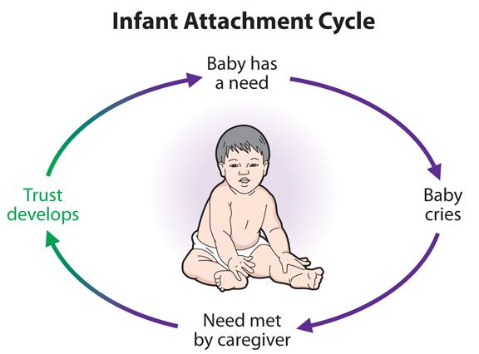
Notes:
Talk through physiological need being translated (are you hungry?, oh you must be tired!) by the caregiver and labelling feelings, soothing, reassuring
Attachment was driven by biological need
Link to proximity, sensitivity and co-regulation
Comparison to other animals and dependency
Then become about emotional security

Slide 4


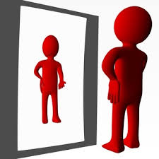

Our Inner Working Model
Other people are….…
The world is...…
I am……
Through consistent, sensitive and timely responses to their needs, the infant acquires a basic trust:
in others as responsive
in the world as a benign place
and in themselves as able to communicate their needs
Notes:
Multiple models
Give both positive and negative examples for each

Slide 5
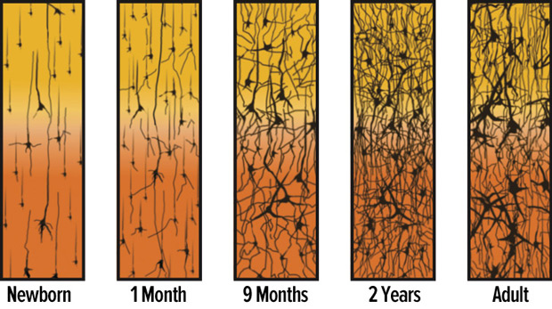
Notes:
This demonstrates connections of neurons in the brain. You can see the rapid change in number and density through experience and how rapid this is in the first two years. Connections are made through experience. For example, if you were to walk across a freshly laid turf to get to a new shed. Over time a path would develop and it makes it easier to follow this path in the future. Use it or lose it- pruning occurs at certain stages. needed repeated experiences to lay these connections. This is why the early experiences are so important. Brain is most plastic in early years- that it is it can change and develop in relation to experience easier. Harder to change later in life. Rapid brain development in the early years many neuronal connections develop in response to experiences.
It becomes important, as clinicians, to understand what’s happening in our brains, ours and our clients, in the therapeutic relationship, to understand what attachment theory and research over the last 50 years and modern neuroscience of the last 20 years are telling us:
our earliest relationships actually build the brain structures we use for relating lifelong;
experiences in those early relationships encode in the neural circuitry of our brains by 12-18 months of age, entirely in implicit memory outside of awareness; these patterns of attachment become the “rules”, templates, schemas, for relating that operate lifelong, the “known but not remembered” givens of our relational lives.
when those early experiences have been less than optimal, those unconscious patterns of attachment can continue to shape the perceptions and responses of the brain to new relational experiences in old ways that get stuck, that can’t take in new experience as new information, can’t learn or adapt or grow from those experiences. What we have come to call, from outside the brain looking in, as the defensive patterns of personality disorders. What one clinician calls “tragic recursive patterns that become encased in neural cement.”
Fortunately, the human brain has always had the biologically innate capacity to grow new neurons – lifelong – and more importantly, to create new synaptic connections between neurons lifelong. All of us can create new patterns of neural firing from new experiences. All of us can pair old even maladaptive patterns with new, more adaptive, patterns of neural firing. All of us can all create new neural circuitry, pathways and networks that allow us to relate, moment by moment in new, healthier, more resilient ways. All of us can store those new more adaptive patterns in both the structures of explicit memory, making them retrievable to conscious awareness and conscious healthy functioning, and in the structures of implicit memory, making them the new habits of relating.

Slide 6
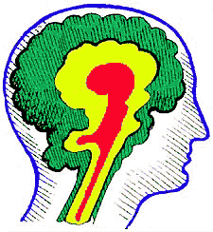
The neuroscience of attachment
Mammalian brain
(feeling)
Higher human brain
(thinking)
Reptilian brain
(primitive)
Co- regulation – Self-regulation = Emotional regulation
Neuroplasticity
Notes:
The Social Brain
– mirror neuronsA mirror neuron is a neuron that fires both when an animal acts and when the animal observes the same action performed by another. Thus, the neuron "mirrors" the behavior of the other, as though the observer were itself acting. Such neurons have been directly observed in primate species.
- Our brains respond and develop in relation to the environment they experience
The Feeling Brain – limbic system
The Thinking Brain – helping us to make sense of our feelings
Co-regulation – care giver acts as the thinking brain to support the child to regulate
Self-regulation – child internalises that process, through consistent co-regulatory experiences.
Attachment is a hidden regulator! When you need something, you call on your attachment figure.
If co-regulation doesn’t occur through inconsistent or absence from caregiver, infant needs to find another way to regulate their feelings.
If don’t have an internal sense of security – can’t take risks ‘such as learning new things’
Neuro-plasticity – it’s never to late. Children with insecure attachment styles can development secure attachment styles with the right environment. However, they remain vulnerable when under stress or threat.

Slide 7
Attachment style and social competence
Insecurely attached children tend to have poorer quality friendships, reduced emotional intelligence & empathy and experience difficulties maintaining friendships (Grossmann and Grossmann 1991).
Insecure attachment style has been linked to anxiety and social withdrawal (LaFreniere et al. 1992; Lyons-Ruth and Jacobvitz 1999; Rubin and Lollis 1988).

Slide 8
Attachment Style and Emotional Regulation (ER)
Attachment is the foundation of emotion regulation
(Sroufe 1996).
ER has a mediating impact on academic outcomes and social competence
ER is the foundation to accepting challenges at school.
Children with insecure attachments have fewer coping skills, are less willing to take on potentially frustrating tasks, less able to discuss emotional topics without anger, and respond negatively to novel situations at school. (Kobak et al. 1993; Sroufe 1996).
Overactive amygdala (fight fright freeze) = increased arousal and anxiety. (Blair 2001)
Notes:
Link to increased cortisol levels

Slide 9
Attachment style and attention
Anxiety impairs ability to control attention, executive functions, memory, and problem-solving, and increases task-irrelevant thoughts (Fincham et al. 1989; Ialongo et al. 1994; Egeland et al. 1993).
Children with insecure attachment styles are more likely to be diagnosed with ADHD, or have ADHD symptoms regardless of being diagnosed (Clarke et al. 2002)

Slide 10
Attachment style and mental health
Insecure attachment is a risk factor for mental ill health.
compared to teenagers with secure attachment, teenage with insecure attachment suffer greater rates of maladjustment, suicidal thoughts, depression, conduct disorders, substance abuse, and eating disorders (Allen and Land 1999; Hesse 1999; Lewis et al. 2000; Weinfield et al. 1999).

Slide 11
Attachment Style and academic outcomes
Security of attachment predicts academic achievement:
Research has found that children with an insecure attachment style tend to have lower verbal ability, math ability, reading comprehension, and overall academic achievement, and exhibit less curiosity than securely attached children
(Granot and Mayseless 2001; Jacobsen and Hofmann 1997; Pianta and Harbers 1996; Weinfield et al. 1999)
Notes:
Executive functioning?
Development of frontal lobe?

Slide 12
Attachment and behaviour: Adaptive responses
Many of the ways these pupils are interacting with us, their peers and the learning context are adaptive responses, learned in order to cope with very challenging and often dangerous situations outside school.
It is important to remember that although they are unhelpful now within the school context, these adaptive responses serve or have served our pupils extremely well, in terms of survival.
Now these adaptive responses can significantly interfere with the pupils ability to settle and learn. Their own defences put them at risk of missing out again.
It can often be masked, but there is often an undercurrent of fear or panic in the challenging behaviours that we see.
Notes:
Fighting with siblings- only way to get attention/food terrible for peer relationships and in school however had a strong function for keeping these young people safe.

Slide 13
Attachment Friendly Frameworks for supporting behaviour
Research on attachment suggests that a relational rather than behavioural framework for supporting children’s behaviour is more effective in supporting children’s behaviour (Bergin and Bergin, 2009, Riley, 2010, Cozolino, 2013)
A behavioural framework which relies entirely on rewards and sanctions to modify children’s behaviour is not necessarily the most effective model and does not always work
A relational framework promotes universal well-being, learning and behaviour and can be especially helpful with children who have attachment difficulties or other vulnerabilities
A relational framework acknowledges that all behaviour is a form of communication and adopts a ‘no-blame’ ethos
For an example see ‘ Developing an Attachment Aware Behaviour Regulation Policy: Guidance for Brighton and Hove School, September 2018’
Trauma aware/trauma senstiive schools’
Notes:
Key adult
As the relationships that a young person has experienced may be the reason and cause of difficulties in their life- so will it be the tool to heal and solve these difficulties.
volunteers

Slide 14
Exclusion from an attachment lens
Recap: Attachment is about relationships, and our mental models of relationships.
What is the psychological impact of being excluded from school for children and young people who have not yet developed secure attachments?
Notes:
How might this reinforce already existing ideas about them selves, others adults and their view of the world?

Slide 15
Working with trauma: secondary stress
School leaders need to be aware of the ‘secondary stress’ symptoms that can impact on staff who are working with children who have experienced trauma and loss.
Consideration needs to be given to ensure staff are appropriately supported through regular supervision, training and support.
‘When working with disturbed children, one might find oneself feeling hurt, abused, angry, frustrated, intolerant, anxious, de-skilled and even frightened. One of the reasons that working with children experiencing emotional and behavioural difficulties is so disturbing is that such intense and painful feelings are somehow pushed [or projected] into the staff (as well as other children). Sometimes it might feel as if it is difficult to know where the feelings are coming from, and the intensity of them might lead one to question one’s own competence and professional worth’
Greenhalgh (1994)

Slide 16
Helping children to heal
Our brains have plasticity - we can always learn new things (as long as we feel safe).
Children and young people who have experienced trauma or neglect need to be provided with what they missed out on in their early years – a safe base from which to explore and learn.
The pre fontal cortex develops through safe, meaningful and genuine interactions with sensitive, responsive, caring and consistent caregiving.
How do we ensure children have access to this in their schools and care placements?
All children need positive relationships (secure attachments) to thrive.
Traumatised or neglected young people need positive relationships to heal.
Notes:
Ensuring that school staff are appropriately trained, that behaviour policies recognise the impotantce of learning opportunities
Relationships are the source of their difficulties and so it will be the tool for change.

Slide 17
How can we give insecurely attached children the same experience?
The art of translation – we are in a prime position to introduce our pupils to a world of secure attachment:
How can our schools support children and young people:
To develop trust in adults – to be able to use as ‘Secure Base’
To develop confidence in the availability of adults
To know adults can be relied upon
To feel good about themselves
To know they are valued
Notes:
Remember how as a baby, the good enough parent would translate the emotions that are being experienced by the infant into something they can handle – we need to do the same for children who have missed this part of development – regardless of chronological age empathy and connection before correction.
Hour long therapy once a week not enough to heal relational trauma every relationship is a therapeutic tool within a school that can make a differenc.e

Slide 18
S.S.S.: the big 3 that can help
Therapeutic ingredients that appear to promote attachment when provided by teachers and caregivers include the following:
Security (sense of psychological safety)
Stability (permanence of the attachment figure)
Sensitivity (emotional availability)

